Slide 1
Chapter 17: Indexing (cont.)

Slide 2
Inserting
Topic: Inserting the search key x into a B-tree
Two limitation condition:
p
Means what???
The maximum number of pointers in a B⁺ tree node is p
P_{leaf}
Means what???
The maximum number of pointers in a B⁺ tree leaf node is p_{leaf}

Slide 3
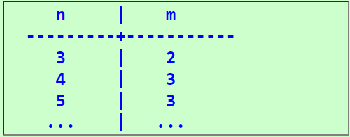
Inserting (cont.)
Definition: the middle key
The middle key is the key with the index equal to:
Examples:

Slide 4
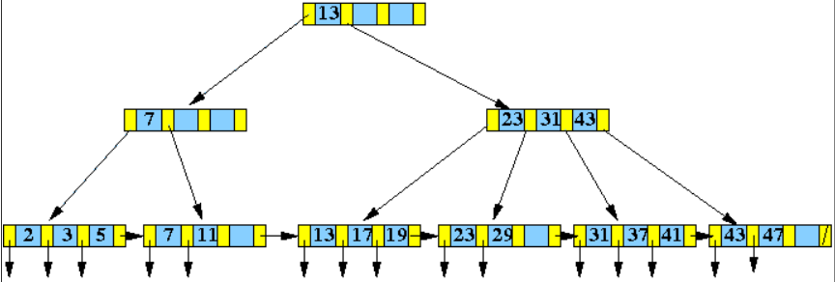
Example 1 of Insert: Leaf Node Has Space
Insert (10, recordPtr(10)) into the following B+-tree:

Slide 5
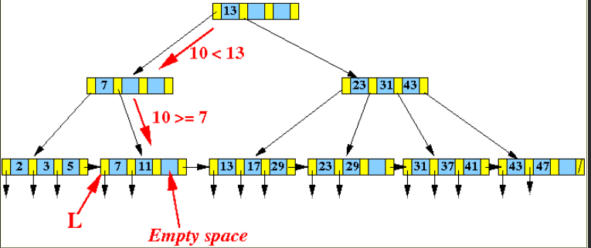
Example 1 of Insert: Leaf Node Has Space (cont.)
Find the leaf node L that would contain search key 10:

Slide 6
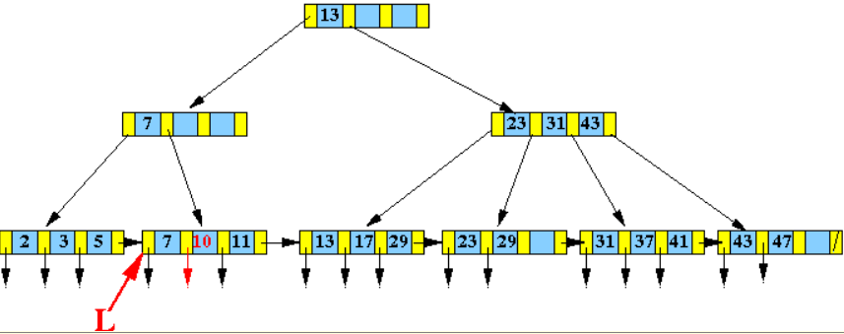
Example 1 of Insert: Leaf Node Has Space (cont.)
Shift keys and insert ( 10, recordPtr(10) ) into the correct position:

Slide 7
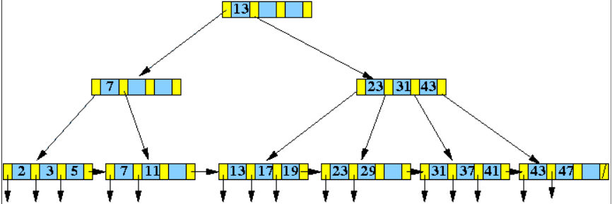
Example 2: Leaf Node is Full
Cascade insert up 1 level
Insert (4, recordPtr(4)) into the following B+-tree:

Slide 8
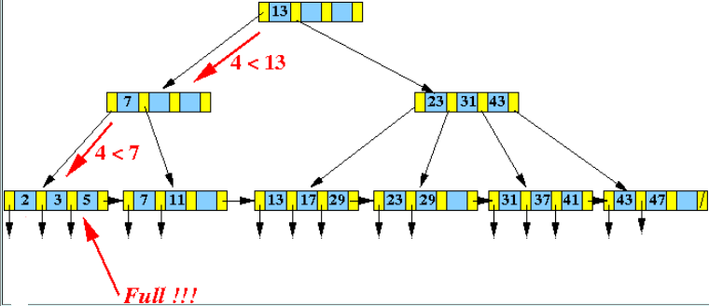
Example 2: Leaf Node is Full (cont.)
Find the leaf node L that would contain search key 4:

Slide 9
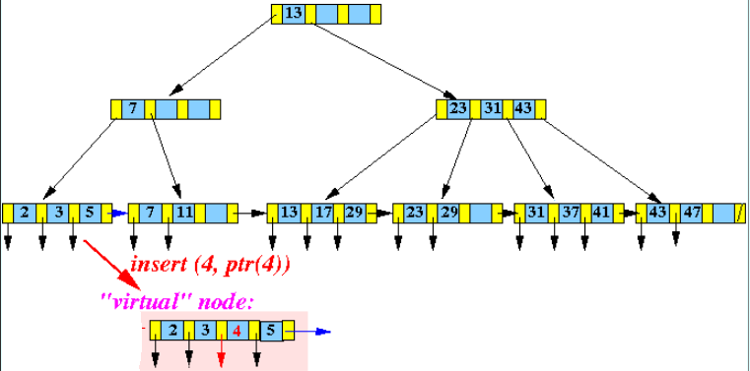
Example 2: Leaf Node is Full (cont.)
Make a virtual node by inserting ( 4, recordPtr(4) ) into the correct position:
The virtual node does not exist !
This step is only done to help you visualize the insert algorithm

Slide 10
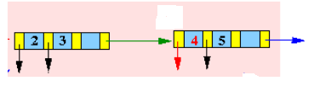
Example 2: Leaf Node is Full (cont.)
Split this virtual node into 2 "equal" halves:

Slide 11
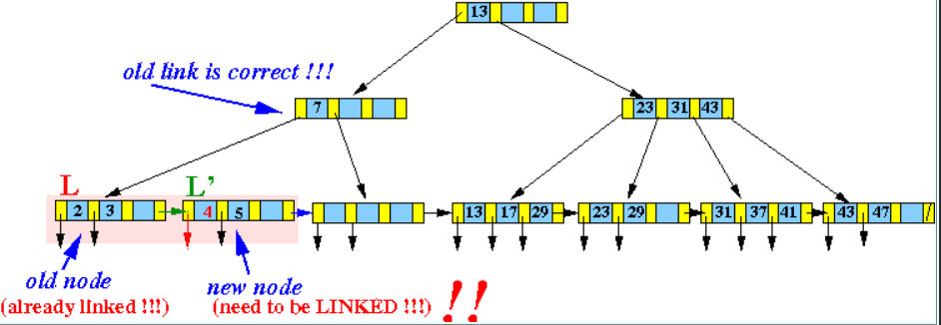
Example 2: Leaf Node is Full (cont.)
Redrawn:
7
11

Slide 12
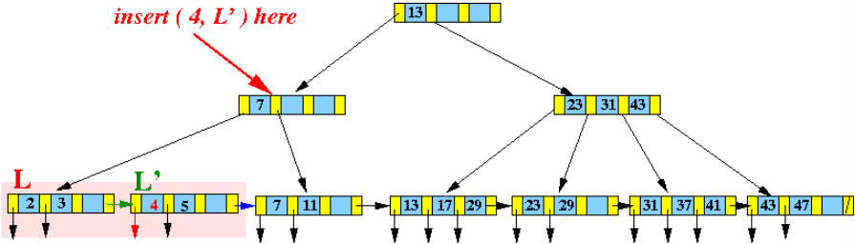
Example 2: Leaf Node is Full (cont.)
The middle search key (= 4) (and the new node pointer L') --- insert (4, L') --- into the parent node of L

Slide 13
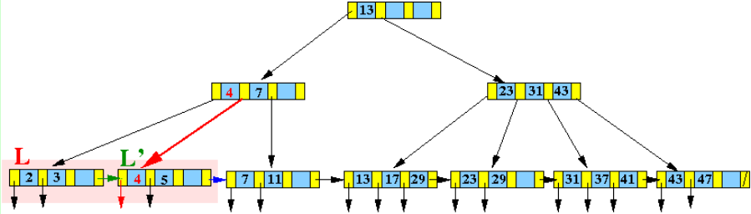
Example 2: Leaf Node is Full (cont.)
Result
Notice that the node L' is the right subtree of the key 4 !!!

Slide 14
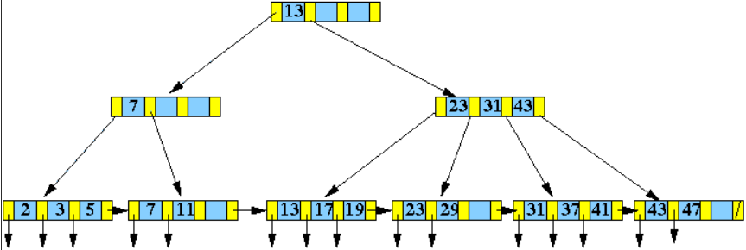
Example 3: Leaf Node is Full - Cascade Insert Up Multiple Levels
Insert ( 40, recordPtr(40) ) into the following B⁺-tree:

Slide 15
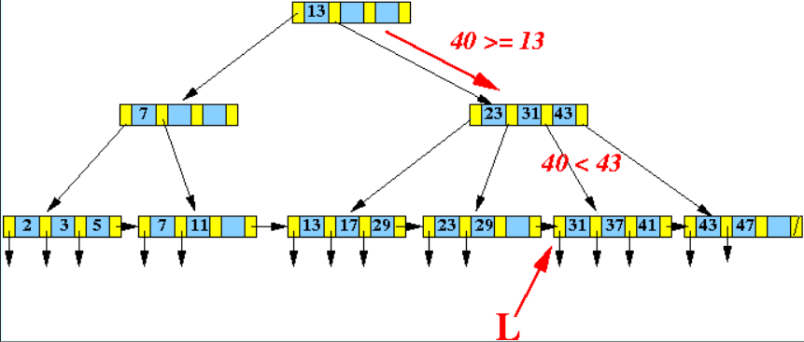
Example 3: Leaf Node is Full - Cascade Insert Up Multiple Levels (cont.)
Find the leaf node L that would contain search key 40:

Slide 16
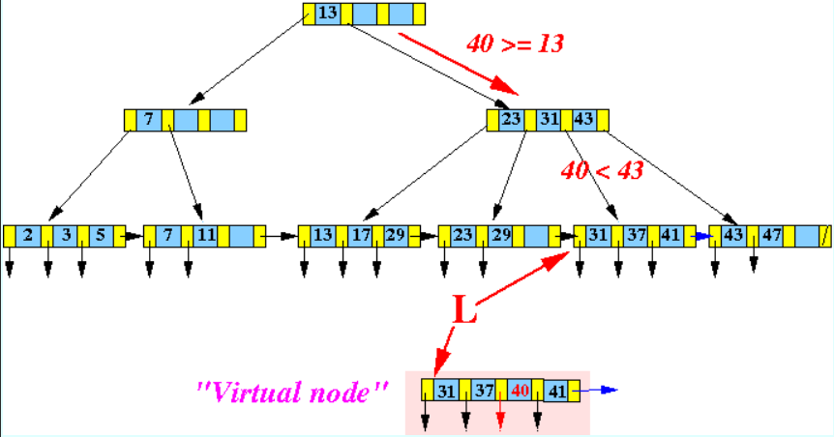
Example 3: Leaf Node is Full - Cascade Insert Up Multiple Levels (cont.)
Make a virtual node by inserting ( 40, recordPtr(40) ) into the correct position:
The virtual node does not exist !
This step is only done to help you visualize the insert algorithm

Slide 17
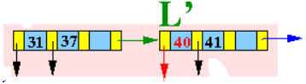
Example 3: Leaf Node is Full - Cascade Insert Up Multiple Levels (cont.)
Split this virtual node into 2 "equal" halves:

Slide 18
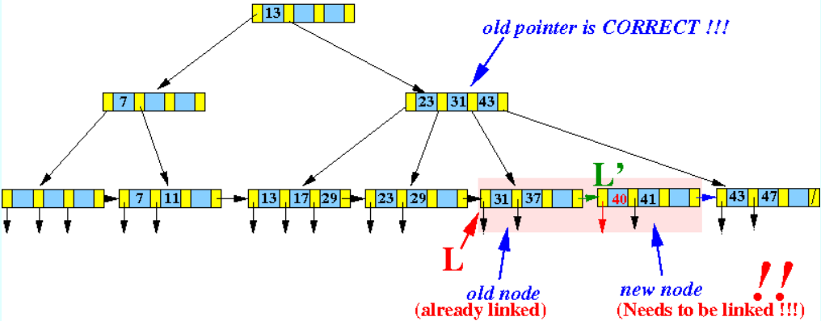
Example 3: Leaf Node is Full - Cascade Insert Up Multiple Levels (cont.)
Redrawn

Slide 19
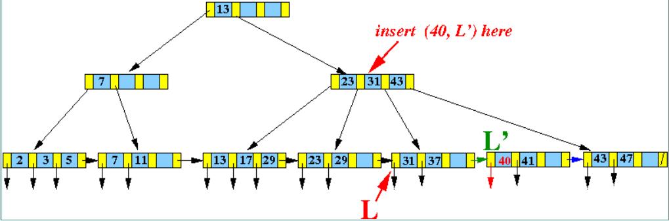
Example 3: Leaf Node is Full - Cascade Insert Up Multiple Levels (cont.)
Insert (40, L') into the parent node of L

Slide 20
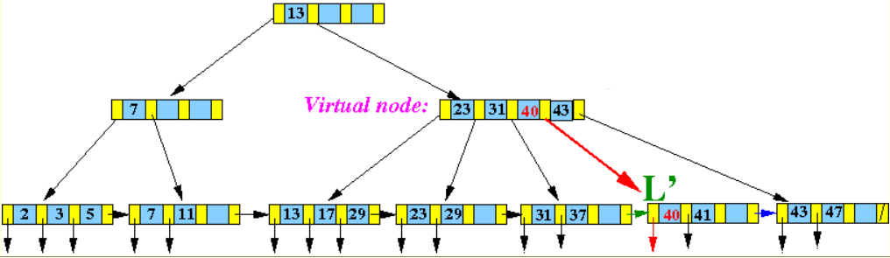

Example 3: Leaf Node is Full - Cascade Insert Up Multiple Levels (cont.)
Insert (40, L') into the parent node of L (cont.)

Slide 21
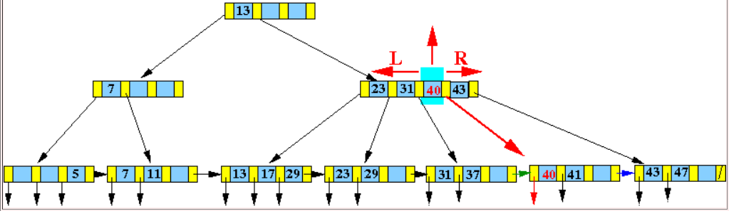
Example 3: Leaf Node is Full - Cascade Insert Up Multiple Levels (cont.)
Split this virtual node into 3 parts:
Take the middle node out !!!
Make a left half node L
Make a right half node R

Slide 22
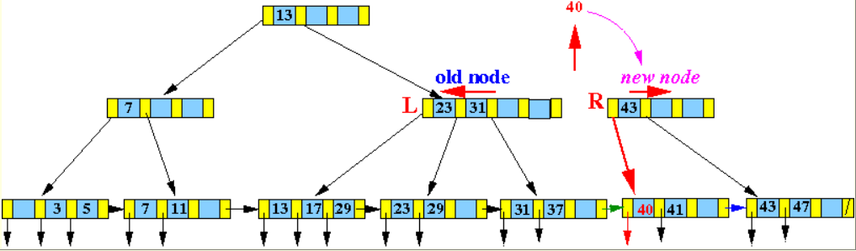
Example 3: Leaf Node is Full - Cascade Insert Up Multiple Levels (cont.)
Result:
Notice that the new node R is the right subtree of the key 40 !!!

Slide 23
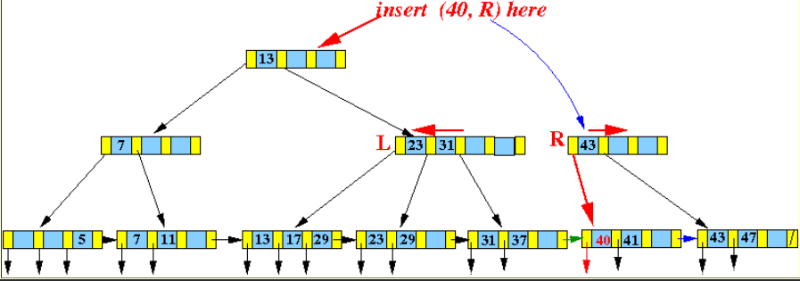
Example 3: Leaf Node is Full - Cascade Insert Up Multiple Levels (cont.)
Insert 40 into its parent:

Slide 24
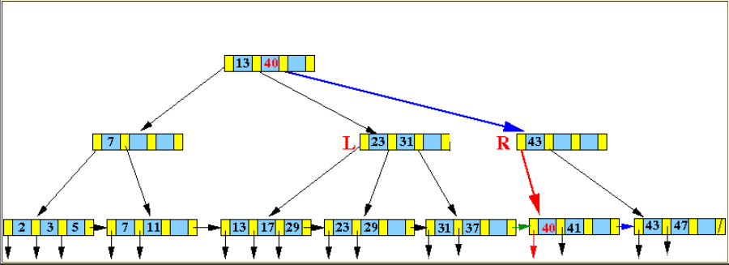
Example 3: Leaf Node is Full - Cascade Insert Up Multiple Levels (cont.)
Result:

Slide 25
Discussion of the Homework (cont.)
A PARTS file with Part# as the key field includes records with the following Part# values:
23, 65, 37, 60, 46, 92, 48, 71, 56, 59, 18, 21, 10, 74, 78
Suppose that the search field values are inserted in the given order
Into B⁺-tree of order p = 4 and p_{leaf} = 3
Question: show how the tree will expand and the final tree

Slide 26
Discussion of the Homework
p = 4!
Means what???
The maximum number of pointers in a B⁺ tree node is 4
P_{leaf} = 3!
Means what???
The maximum number of pointers in a B⁺ tree leaf node is 4

Slide 27
Insert 23, 65, 37
23, 65, 37, 60, 46, 92, 48, 71, 56, 59, 18, 21, 10, 74, 78
Insert 23, 65. 37
Insert 60
23
37
65
Right or Wrong?
Split
23
37
65
60
23
37
60
65

Slide 28
Insert 60
23, 65, 37, 60, 46, 92, 48, 71, 56, 59, 18, 21, 10, 74, 78
Insert 60
37
Split
23
37
60
65
23
37
60
65

Slide 29
Insert 46
23, 65, 37, 60, 46, 92, 48, 71, 56, 59, 18, 21, 10, 74, 78
Insert 46
37
37
23
37
60
65
46
23
37
46
60
65

Slide 30
Insert 92
23, 65, 37, 60, 46, 92, 48, 71, 56, 59, 18, 21, 10, 74, 78
Insert 92
37
Split
23
37
46
60
65
46
60
65
92

Slide 31
Insert 92 (cont.)
23, 65, 37, 60, 46, 92, 48, 71, 56, 59, 18, 21, 10, 74, 78
Insert 92
Split
46
60
65
92
37
60
23
37
46
60
65
92

Slide 32
Insert 48, 71
23, 65, 37, 60, 46, 92, 48, 71, 56, 59, 18, 21, 10, 74, 78
Insert 48, 71
37
60
23
37
46
48
60
65
71
92

Slide 33
Insert 56
23, 65, 37, 60, 46, 92, 48, 71, 56, 59, 18, 21, 10, 74, 78
Insert 56
Split
46
48
60
56
37
60
23
37
46
48
60
65
71
92

Slide 34
Insert 56 (cont.)
23, 65, 37, 60, 46, 92, 48, 71, 56, 59, 18, 21, 10, 74, 78
Insert 56
Split
46
48
60
56
37
48
60
23
37
46
48
56
60
65
71
92

